Slide 1

Customer Shopping Trends Analytics
Analyzing 3,900 customer purchases to uncover spending patterns, preferences, and strategic opportunities for business growth.

Slide 2

Dataset Overview
3,900
18
50
Total Purchases
Data Features
Locations
Transactions analyzed across all categories
Comprehensive customer and purchase attributes
Geographic diversity across customer base
25
Product Types
Items spanning multiple categories

Slide 3

Data Preparation Process
01
Data Loading & Exploration
Imported dataset using pandas and performed initial structure analysis with summary statistics.
02
Missing Data Handling
Imputed 37 missing Review Rating values using median rating by product category.
03
Feature Engineering
Created age_group bins and purchase_frequency_days columns for deeper insights.
04
Database Integration
Connected to PostgreSQL and loaded cleaned data for SQL analysis.

Slide 4

Customer Demographics
Key Statistics
Age Range: 18-70 years (median: 44)
Gender Split: 68% Male, 32% Female
Subscription Rate: 27% subscribed
Average Rating: 3.75 out of 5.0
Customers span diverse age groups with consistent engagement across demographics.

Slide 5
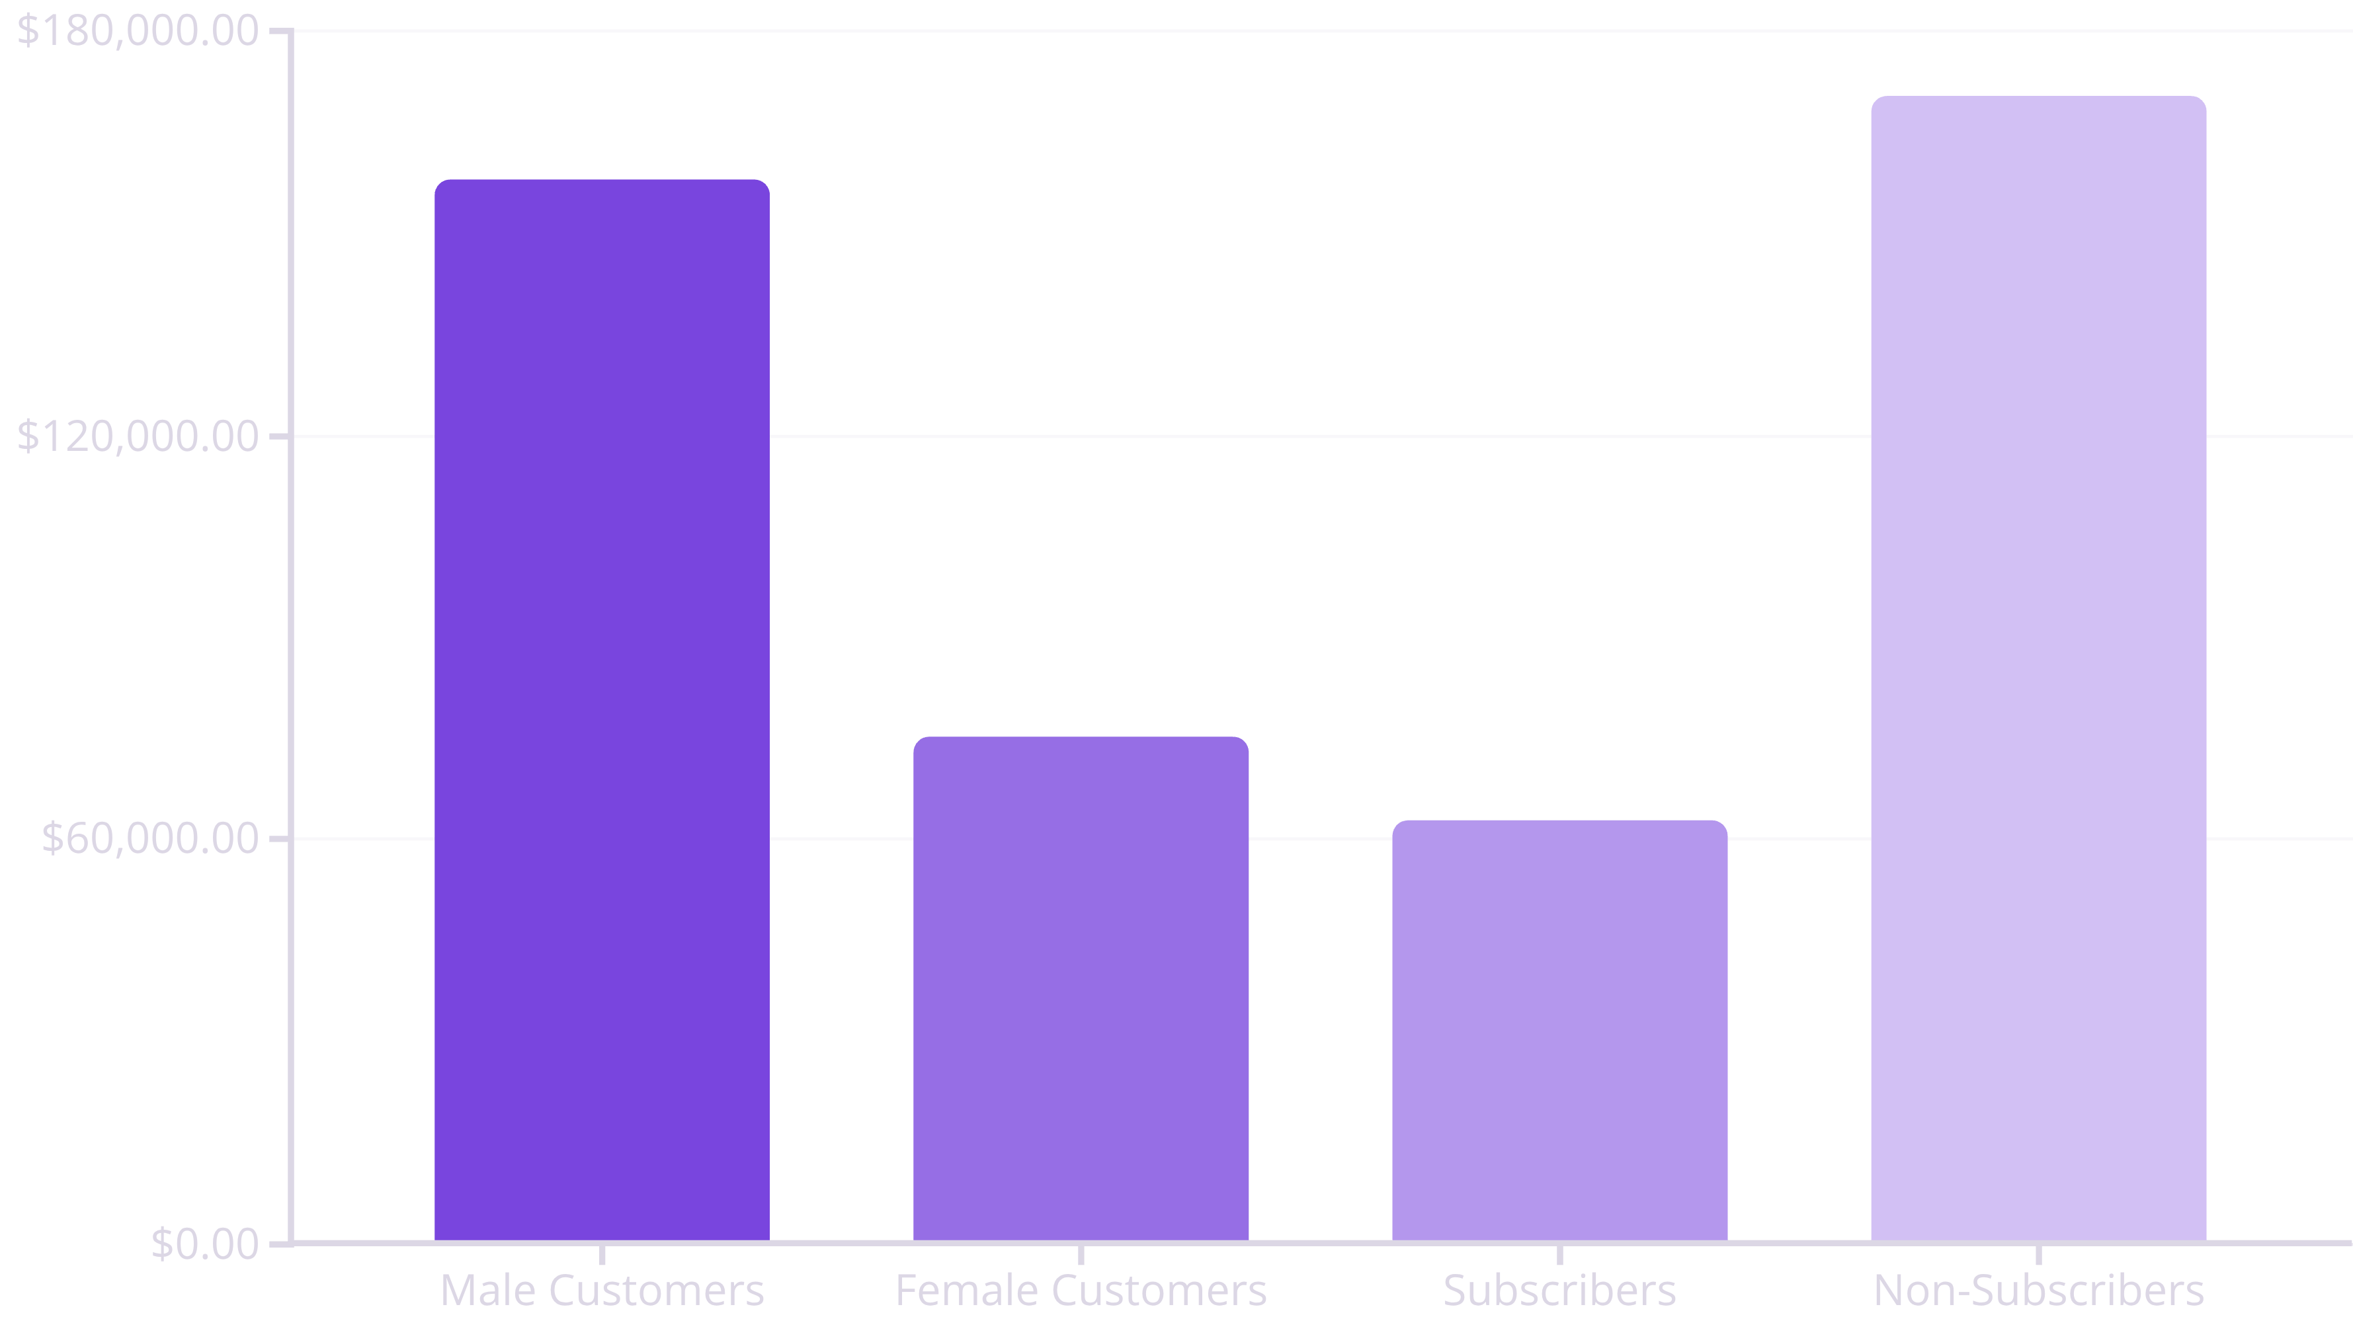
Revenue Analysis
Male customers generate 68% of total revenue. Non-subscribers contribute significantly more revenue but represent 73% of the customer base, suggesting untapped subscription potential.

Slide 6

Product Performance Insights
Top Rated: Gloves
Runner-up: Sandals
Third Place: Boots
3.86 average rating - highest customer satisfaction
3.84 rating with strong seasonal demand
3.82 rating - consistent performer
Discount Insight: 839 customers used discounts but still spent above average ($59.76), indicating price-insensitive segments exist.

Slide 7




Customer Segmentation
Returning
701 customers (18%)
Loyal Customers
Growing engagement potential
3,116 customers (80%)
Repeat buyers driving consistent revenue
New Customers
83 customers (2%)
Fresh acquisition opportunities
Strong loyalty base provides foundation for growth. Focus on converting returning customers to loyal status.

Slide 8


Shipping & Subscription Patterns
Shipping Preferences
Subscription Impact
Repeat Buyers (>5 purchases):
958 are subscribers
2,518 are non-subscribers
60.48
Only 28% of repeat buyers subscribe, revealing significant conversion opportunity.
Express
Average purchase amount
58.46
Standard
Average purchase amount
Express shipping users spend 3.5% more on average, indicating willingness to pay premium for speed.

Slide 9
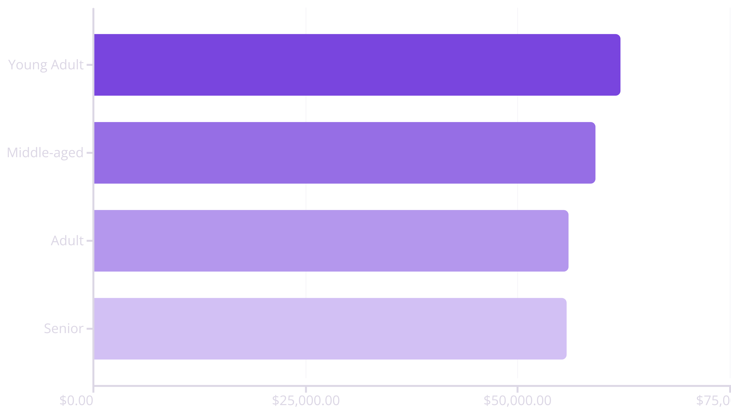
Age Group Revenue Distribution
Young adults lead revenue generation, but all age groups contribute relatively evenly, suggesting broad market appeal and balanced targeting opportunities.

Slide 10





Strategic Recommendations
Boost Subscriptions
Promote exclusive benefits to convert the 2,518 repeat non-subscribers into loyal subscribers.
Loyalty Programs
Reward repeat buyers to accelerate movement into the loyal customer segment.
Optimize Discounts
Balance promotional sales with margin control—839 customers spend above average even with discounts.
Targeted Marketing
Focus campaigns on high-revenue age groups, top-rated products, and express shipping users.

